Slide 1
Volunteer Opportunities for Employees
Erica Esinam Gelly

Slide 2
What Is Operation Give Back™?
Employee volunteer program
Coordinated by Brian Sarkar, Practice Manager
Opportunities to volunteer with fellow employees
Do good
Feel good!
Three days scheduled each year

Slide 3
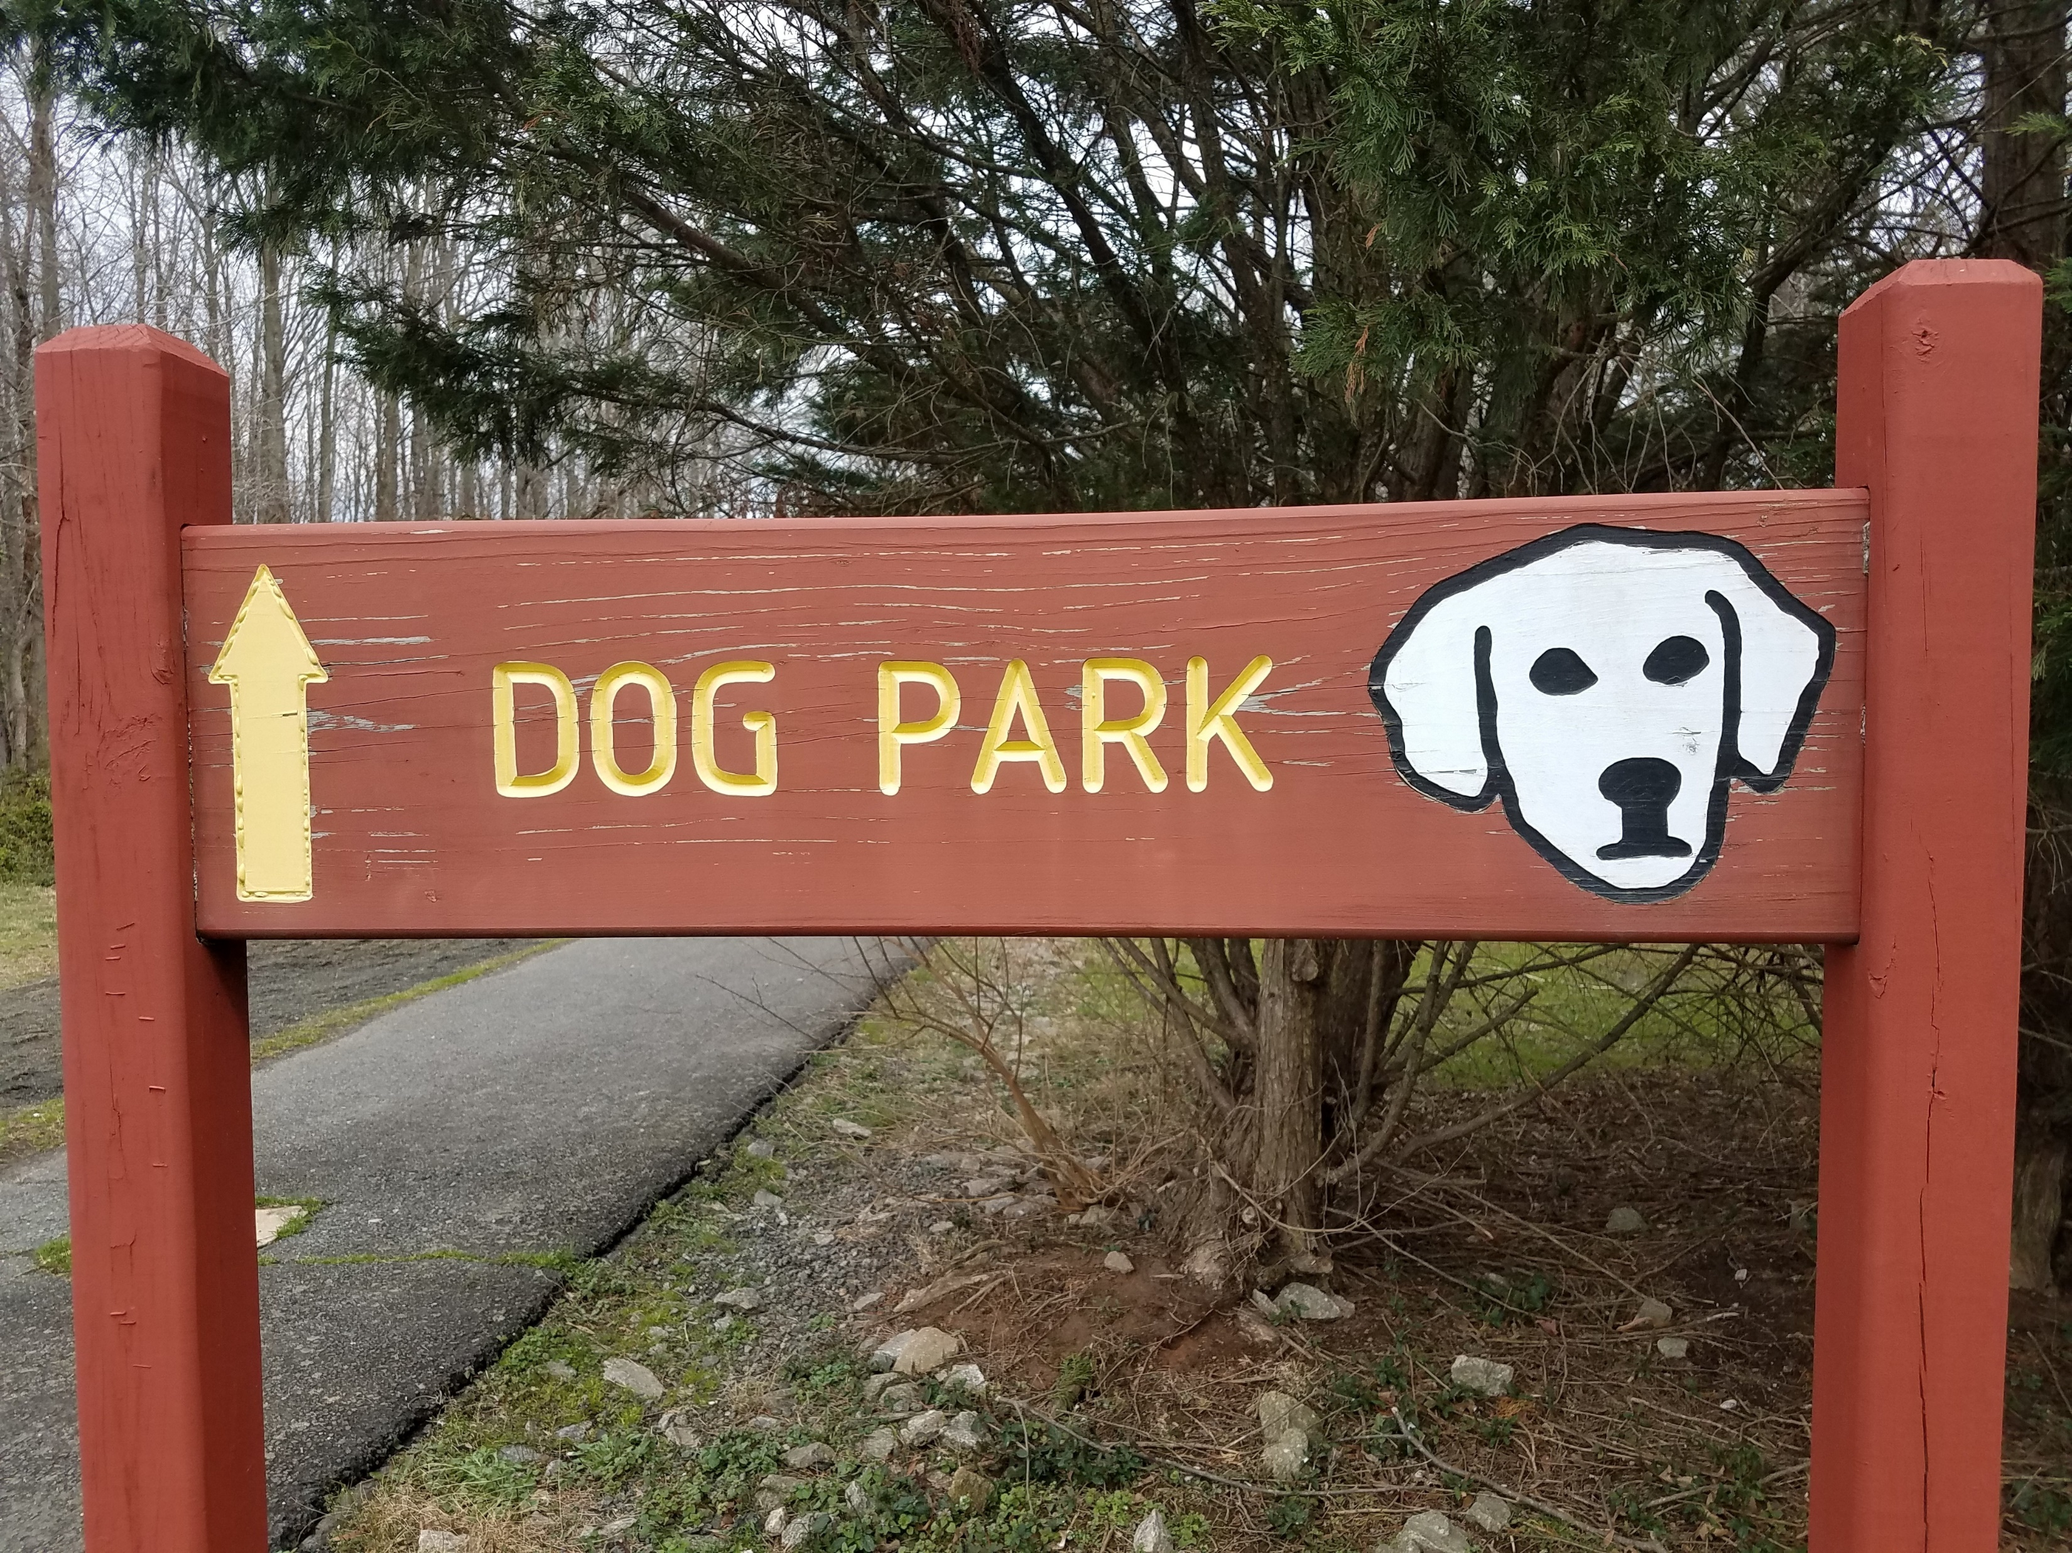
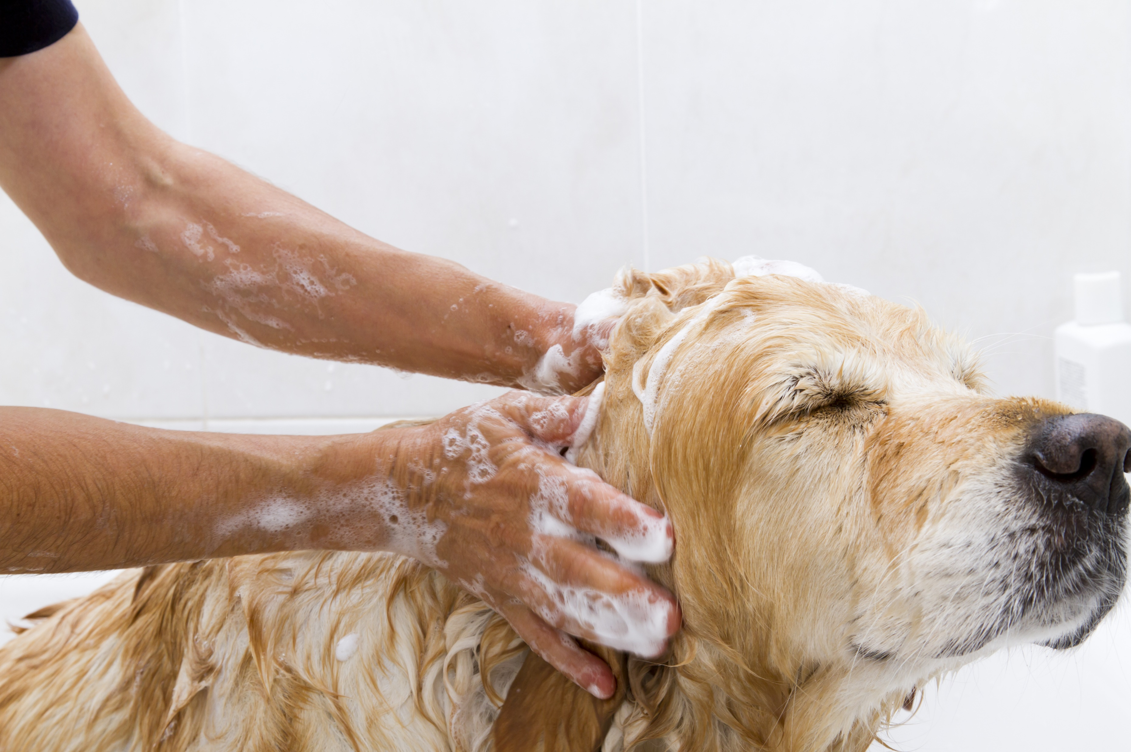
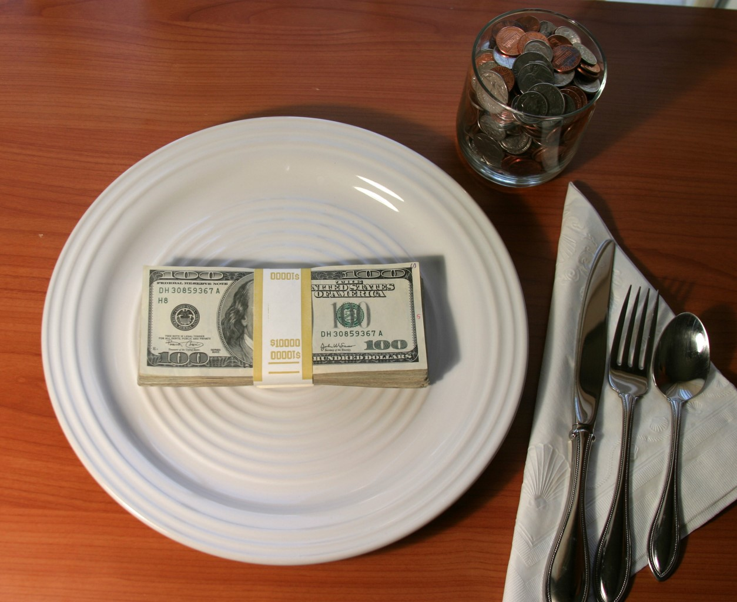
2021 Give Back Days
 | Description | Date
 | Groom animals at city animal Shelter | Saturday, April 24
 | Clean up city dog parks | Saturday, June 19
 | Annual fundraiser dinner for city animal shelter | Sunday, September 12

Slide 4
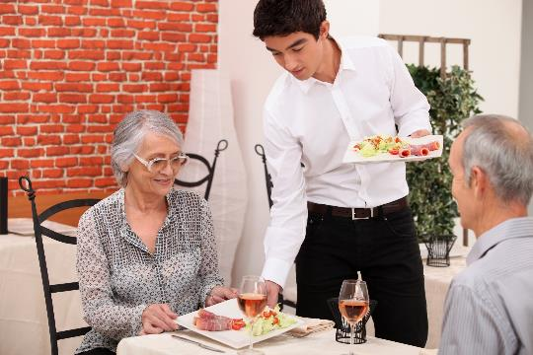
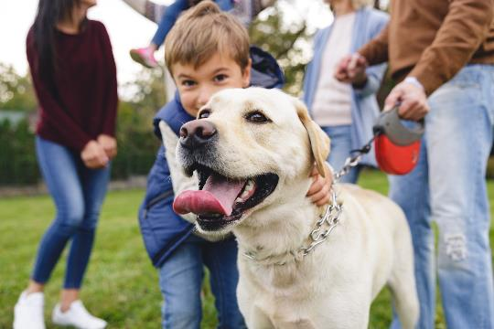
Scences from last year

Slide 5
Ben Kim, Veterinary technician, waiting tables at last year’s fundraiser

Slide 6
Randy, son of Kathy Turner, HR Director enjoying the dog park after the clean-up last year

Slide 7
Join the Gang!

Slide 8


Slide 9
Sign Up Today!
Brian Sarkar b.sarkar@wvh.example.com
or
Tereza Gon\;alves t.goncalves@wvh.example.com
This way to feel great an help others!

